Slide 1
Machine Learning
April-24-2015

Slide 2
A Few Quotes
“A breakthrough in machine learning would be worth ten Microsofts” (Bill Gates, Chairman, Microsoft)
“Machine learning is the next Internet” (Tony Tether, Director, DARPA)
“Machine learning is the hot new thing” (John Hennessy, President, Stanford)
“Web rankings today are mostly a matter of machine learning” (Prabhakar Raghavan, Dir. Research, Yahoo)
“Machine learning is going to result in a real revolution” (Greg Papadopoulos, CTO, Sun)
“Machine learning is today’s discontinuity” (Jerry Yang, CEO, Yahoo)

Slide 3
What is Learning ?
According to Herbert Simon (June 15, 1916 – February 9, 2001), learning is, “Any change in a System that allows it to perform better the second time on repetition of the same task or on another task drawn from the same population.” [G. F. Luger and W. A. Stubblefield, Artificial Intelligence: Structures and Strategies for Complex Problem Solving, The Benjamin/Cummings Publishing Company, Inc. 1989.]

Slide 4
So What Is Machine Learning?
Automating automation
Getting computers to program themselves
Writing software is the bottleneck
Let the data do the work instead!

Slide 5
So What Is Machine Learning?
Traditional Programming
Data
Computer
Output
Program
Machine Learning
Data
Computer
Program
Output

Slide 6
Why “Learn”?
Machine learning is programming computers to optimize a performance criterion using example data or past experience.
There is no need to “learn” to calculate payroll
Learning is used when:
Human expertise does not exist (navigating on Mars),
Humans are unable to explain their expertise (speech recognition)
Solution changes in time (routing on a computer network)
Solution needs to be adapted to particular cases (user biometrics)

Slide 7
What We Talk About When We Talk About“Learning”
Learning general models from a data of particular examples
Data is cheap and abundant (data warehouses, data marts); knowledge is expensive and scarce.
Example in retail: Customer transactions to consumer behavior:
People who bought “Da Vinci Code” also bought “The Five People You Meet in Heaven” (www.amazon.com)
Build a model that is a good and useful approximation to the data.

Slide 8
Learning system model
Testing
Input Samples
Learning Method
System
Training

Slide 9
Training and testing
Data acquisition
Practical usage
Universal set
(unobserved)
Training set (observed)
Testing set
(unobserved)

Slide 10
Training and testing
Training is the process of making the system able to learn.
No free lunch rule:
Training set and testing set come from the same distribution
Need to make some assumptions or bias

Slide 11
Performance
There are several factors affecting the performance:
Types of training provided
The form and extent of any initial background knowledge
The type of feedback provided
The learning algorithms used
Two important factors:
Modeling
Optimization

Slide 12
Algorithms
The success of machine learning system also depends on the algorithms.
The algorithms control the search to find and build the knowledge structures.
The learning algorithms should extract useful information from training examples.

Slide 13


Algorithms
Supervised learning ( )
Prediction
Classification (discrete labels), Regression (real values)
Unsupervised learning ( )
Clustering
Probability distribution estimation
Finding association (in features)
Dimension reduction
Semi-supervised learning
Reinforcement learning
Decision making (robot, chess machine)

Slide 14
Algorithms
Supervised learning
Unsupervised learning
Semi-supervised learning

Slide 15
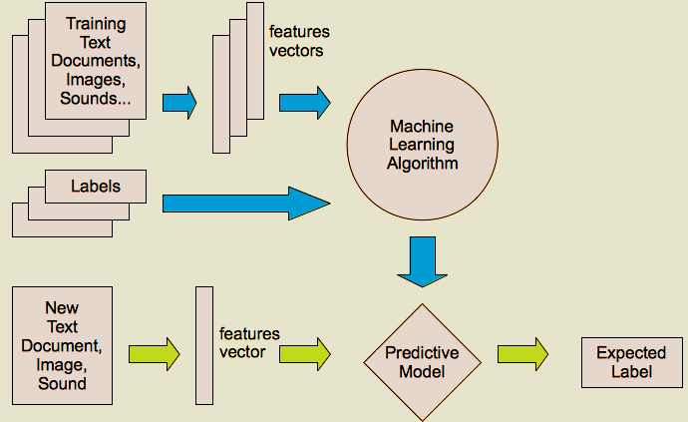
Supervised learning

Slide 16
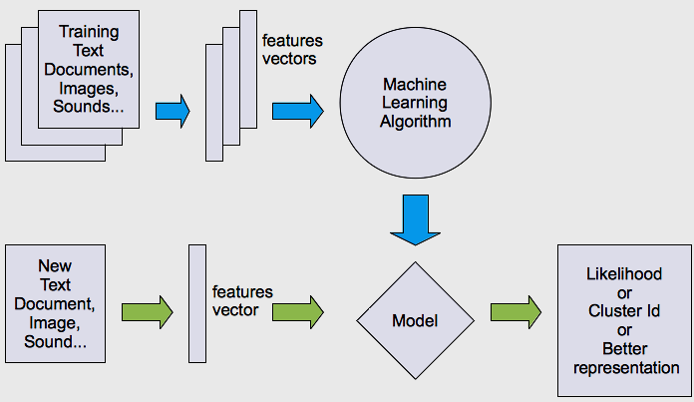
Unsupervised learning

Slide 17




What are we seeking?
Under-fitting VS. Over-fitting (fixed N)
error
(model = hypothesis + loss functions)

Slide 18
Learning techniques
Supervised learning categories and techniques
Linear classifier (numerical functions)
Parametric (Probabilistic functions)
Naïve Bayes, Gaussian discriminant analysis (GDA), Hidden Markov models (HMM), Probabilistic graphical models
Non-parametric (Instance-based functions)
K-nearest neighbors, Kernel regression, Kernel density estimation, Local regression
Non-metric (Symbolic functions)
Classification and regression tree (CART), decision tree
Aggregation
Bagging (bootstrap + aggregation), Adaboost, Random forest

Slide 19
Learning techniques
Unsupervised learning categories and techniques
Clustering
K-means clustering
Spectral clustering
Density Estimation
Gaussian mixture model (GMM)
Graphical models
Dimensionality reduction
Principal component analysis (PCA)
Factor analysis

Slide 20
Learning Associations
Basket analysis:
P (Y | X ) probability that somebody who buys X also buys Y where X and Y are products/services.
Example: P ( chips | beer ) = 0.7
Market-Basket transactions

Slide 21
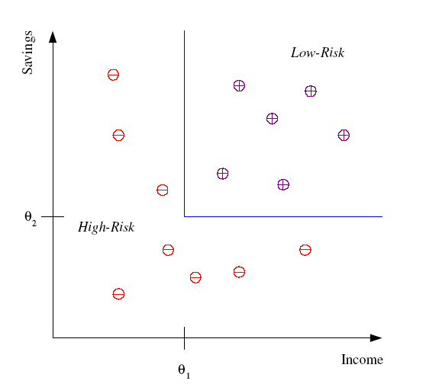
Classification
Example: Credit scoring
Differentiating between low-risk and high-risk customers from their income and savings
Discriminant: IF income > θ₁ AND savings > θ₂
THEN low-risk ELSE high-risk
Model

Slide 22
Classification: Applications
Aka Pattern recognition
Face recognition: Pose, lighting, occlusion (glasses, beard), make-up, hair style
Character recognition: Different handwriting styles.
Speech recognition: Temporal dependency.
Use of a dictionary or the syntax of the language.
Sensor fusion: Combine multiple modalities; eg, visual (lip image) and acoustic for speech
Medical diagnosis: From symptoms to illnesses
Web Advertizing: Predict if a user clicks on an ad on the Internet.

Slide 23








Face Recognition
Training examples of a person
Test images
AT&T Laboratories, Cambridge UK
http://www.uk.research.att.com/facedatabase.html

Slide 24
Support Vector Machine
In machine learning, support vector machines are supervised learning models
Given a set of training examples, each marked as belonging to one of two categories, an SVM training algorithm builds a model that assigns new examples into one category or the other.
An SVM model is a representation of the examples as points in space, mapped so that the examples of the separate categories are divided by a clear gap that is as wide as possible. New examples are then mapped into that same space and predicted to belong to a category based on which side of the gap they fall on.
In addition to performing linear classification, SVMs can efficiently perform a non-linear classification using what is called the kernel trick, implicitly mapping their inputs into high-dimensional feature spaces.

Slide 25
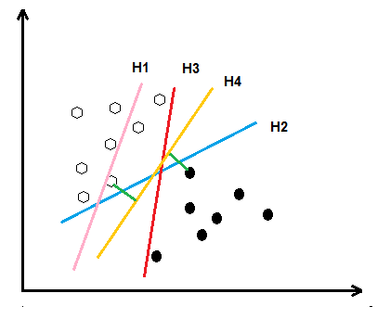
Support Vector Machine
H1: Does not separate the classes
H2 and H3: Separate the classes but with minimum Margin
H4: Separate the classes with maximum Margin

Slide 26

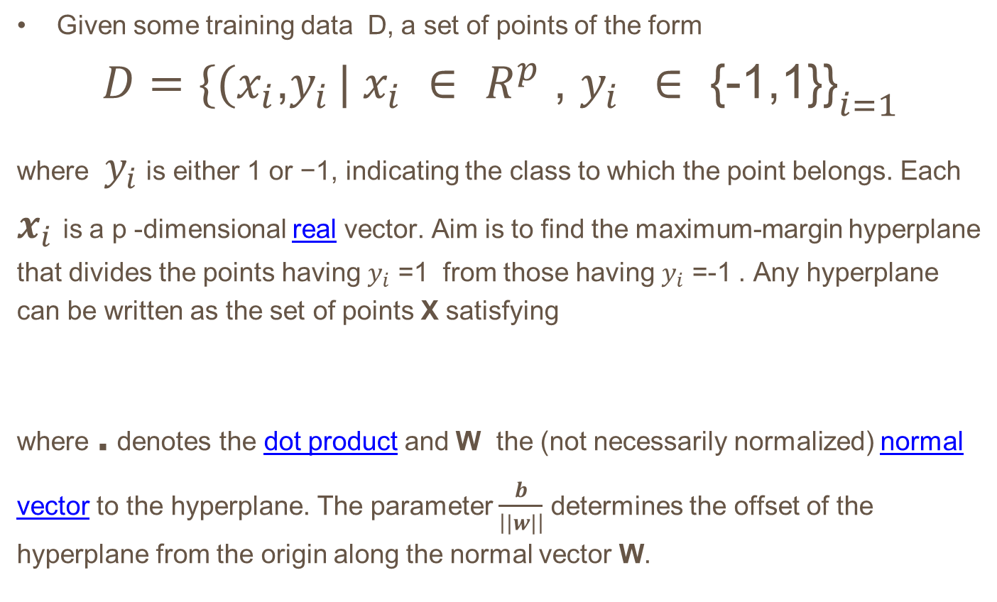
Linear SVM
Given some training data D, a set of points of the form
$$D={\{(x_{i}\text{,}y_{i }| x_{i} ∈ R^{p}\text{ , }y_{i } ∈ \text{\{-1,1\}\}}}_{i=1}^{}$$
where $y_{i}$ is either 1 or −1, indicating the class to which the point belongs. Each $x_{i}$is a p -dimensional real vector. Aim is to find the maximum-margin hyperplane that divides the points having $y_{i}$ =1 from those having $y_{i}$ =-1 . Any hyperplane can be written as the set of points X satisfying
where . denotes the dot product and W the (not necessarily normalized) normal vector to the hyperplane. The parameter $\frac{b}{\left||w|\right|}$ determines the offset of the hyperplane from the origin along the normal vector W.
W . X - b =0

Slide 27
Support Vector Machine
If the training data are linearly separable, we can select two hyperplanes in a way that they separate the data and there are no points between them, and then try to maximize their distance. The region bounded by them is called "the margin". These hyperplanes can be described by the equations
and
W . X - b = 1
W . X - b = -1

Slide 28
Support Vector Machine
Maximum-margin hyperplane and margins for an SVM trained with samples from two classes. Samples on the margin are called the support vectors

Slide 29






Support Vector Machine
By using geometry, we find the distance between these two hyperplanes is
so we want to minimize . As we also have to prevent data points from falling into the margin, we add the following constraint: for each i either
of the first class
Or
of the second.
This can be rewritten as:
We can put this together to get the optimization problem:
Minimize (in w, b )

Slide 30
Support Vector Machine

Slide 31


Slide 32
This new formulation LD is referred to as the Dual form of the Primary LP . It is worth noting that the Dual form requires
only the dot product of each input vector xi to be calculated,
This is precisely what lets us generalize to the nonlinear case.

Slide 33
Constrained Optimization Problem
A constrained optimization problem is a problem of the form maximize (or minimize) the function F(x, y) subject to the condition g(x, y) = 0.
Procedure for Applying the Method of Lagrange Multipliers:
Step #1 First create the LaGrange Function. This function is composed of the function to be optimized combined with the constraint function in the following way:
L(x, y) = f(x, y) – λ [ g(x, y) – k ]
Step #2 Now find the partial derivative with respect to each variable x, y and the Lagrange multiplier $⋋$ of the function shown:
L(x, y) = f(x, y) –λ [ g(x, y) – k ]
Step #3 Set each of the partial derivatives equal to zero to get Lx = 0, Ly = 0 and L_{λ} = 0
Using Lx = 0, Ly = 0, proceed to solve for x and solve for y in terms of λ. Now substitute the solutions for x and y so that L_{λ} = 0 is in terms of λ only. Now solve for λ and use this value to find the optimal values x and y.
Note: If M is the max or min value of f(x, y) subject to the constraint g(x, y) = k, then the Lagrange multiplier λ is the rate of change in M with respect to k.

Slide 34
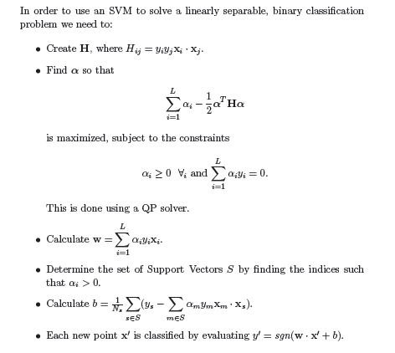
Procedure for Applying the Method of Lagrange Multipliers:

Slide 35
Support Vector Machine
The input x and the support vectors xi are nonlinearly mapped (by F) into a feature space F, where dot products are computed. By the use of the kernel k, these two layers are in practice computed in one single step. The results are linearly combined by weights ni, found by solving a quadratic program. The linear combination is fed into the function s (in pattern recognition, s(x) = sign(x + b); in
regression stimation, s(x) = x + b; in kernel PCA, s(x) = x.

Slide 36


Feature Space and Kernel
The basic idea of SV machines, is to map the data into some other dot product space (called the feature space) F via a nonlinear map
and perform the above linear algorithm in F. Pl note as stated this only requires the evaluation of dot products.
Clearly, if F is high-dimensional, the right hand side of Equation will be very expensive to compute. In some cases, however, there is a simple kernel k that can be evaluated efficiently.

Slide 37
Support Vector Machine
Clearly, if F is high-dimensional, the right hand side of Equation will be very expensive to compute. In some cases, however, there is a simple kernel k that can be evaluated efficiently.

Slide 38
Support Vector Machine

Slide 39
Support Vector Machine

Slide 40
Support Vector Machine

Slide 41
Support Vector Machine

Slide 42
Support Vector Machine

Slide 43
Support Vector Machine

Slide 44
Support Vector Machine

Slide 45

THANK YOU!

Slide 46
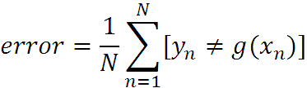
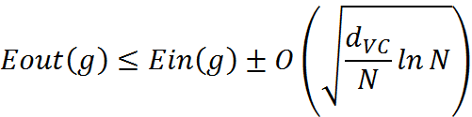
What are we seeking?
Supervised: Low E-out or maximize probabilistic terms
Unsupervised: Minimum quantization error, Minimum distance, MAP, MLE(maximum likelihood estimation)
E-in: for training set
E-out: for testing set

